Slide 1


Team2: Alteryx Progress Presentation 2
Accelerating User Journeys With a Deeper Understanding Of Product Iterations
Presentors: William Wu, Yiqin Chen, Kenny Wei, Ruxi Zheng, Kexin Zhang

Slide 2
Project Objective
Alteryx is a software company that provides a platform for data preparation, analysis, and automation, enabling organizations to make informed decisions based on their data.
Our project aims to analyze user behavior while using the Alteryx platform to identify which events (platform tools usage) lead to increased product usage, and develop strategies to deliver those events to users in order to accelerate customer engagement to reduce churn. We approach this by clustering and data analysis.

Slide 3
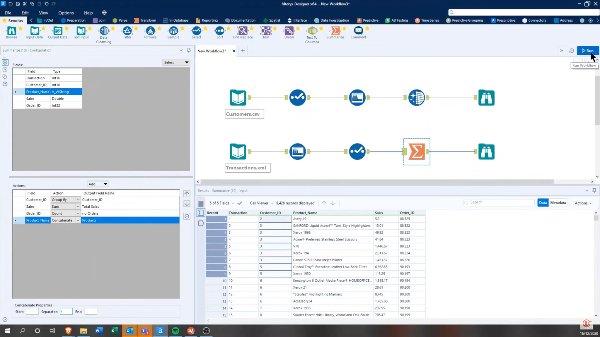
Alteryx platform
Tool Class
Tools of the tool class
Workflow Canvas

Slide 4




Data Description and Management

Slide 5
Data Description and Management
Original Dataset
USERID | RUN_DATE | TOOL_CLASS | TOOL_NAME | UNIQUE_HOUR_RUN | TOOL_COUNT | TOTAL_RUNS
1F2345 | 2022-01-07 | In/Out | Browse | 1 | 6 | 3
234A56 | 2022-02-03 | In/Out | Input Data | 1 | 6 | 3
34C567 | 2022-01-13 | Preparation | Filter | 2 | 3 | 2
User-day-tool level data
USERID: Unique identifier for a user
RUN_DATE: The specific date for a tool usage by a user
TOOL_CLASS: Category for the tool
TOOL_NAME: Name for the tool
UNIQUE_HOURS_RUN: The number of unique hours that a tool run by a user on a day
TOOL_COUNT: Total number of times a tool appeared on a workflow canvas during the day
TOTAL_RUNS: Total number of runs of a tool by a user on a day(should always <= TOOL_COUNT)

Slide 6
Data Description and Management
Workflow Canvas
 | UNIQUE_HOUR_RUN | TOOL_COUNT | TOTAL_RUNS
11:06 1 2 1
11:07 1 4 2
14:00 2 6 3

Slide 7
Feature Engineering
User daily behaviors are unstable, so we measure user behavior of using platform in 7 days level
PERIOD: Number of days using the platform within a period
USER_SCORE: log10(FREQUENCY*TOOL_LIST_COUNT)
FREQUENCY: Number of days using the platform within a period
TOOL_LIST_COUNT: Count of unique tool clusters (tools that run together)
AVG_HOURLY_RUN: The average number of runs per hour for a tool by a user on a day (TOTAL_RUNS/UNIQUE_HOUR_RUN)
UNIQUE_HOUR_RUN, TOOL_COUNT, TOTAL_RUNS: Three numerical features in original data will be averaged in period level and added to the final data
Notes:
Unstable means: users might not use the platform everyday and a day level data is relatively random, so we combine original data spanning a year into weekly data, and created a feature named period
We create a user score to measure user behavior
Frequency of users using the platform and distinct series of tools that user used (TOOL_LIST_COUNT) are two essential features
(Frequency & Tool_list_count), Avg_hourly_runThree numerical features in original data will be averaged in period level and added to the final data
All above features composite our final data: User-Period Level Data

Slide 8
Final Data
USERID | PERIOD | AVG_HOURLY_RUN | TOOL_LIST_COUNT | FREQUENCY | UNIQUE_HOUR_RUN | TOOL_COUNT | TOTAL_RUNS | USER_SCORE
12345 | 1 | 2.00 | 1 | 1 | 2.00 | 4.00 | 4.00 | 0.00
23456 | 12 | 1.00 | 5 | 1 | 2.00 | 3.00 | 5.00 | 0.69
56789 | 44 | 2.53 | 22 | 2 | 1.67 | 13.37 | 3.87 | 1.64
67891 | 15 | 1.72 | 41 | 3 | 1.74 | 6.31 | 4.21 | 2.09
34567 | 17 | 4.24 | 64 | 5 | 1.83 | 11.41 | 320 | 2.51

Slide 9
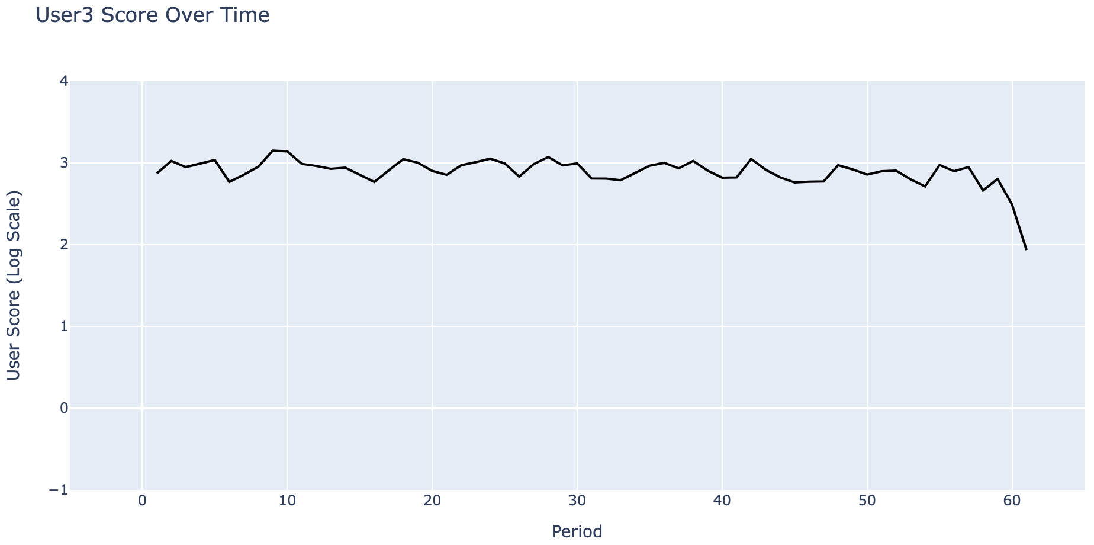
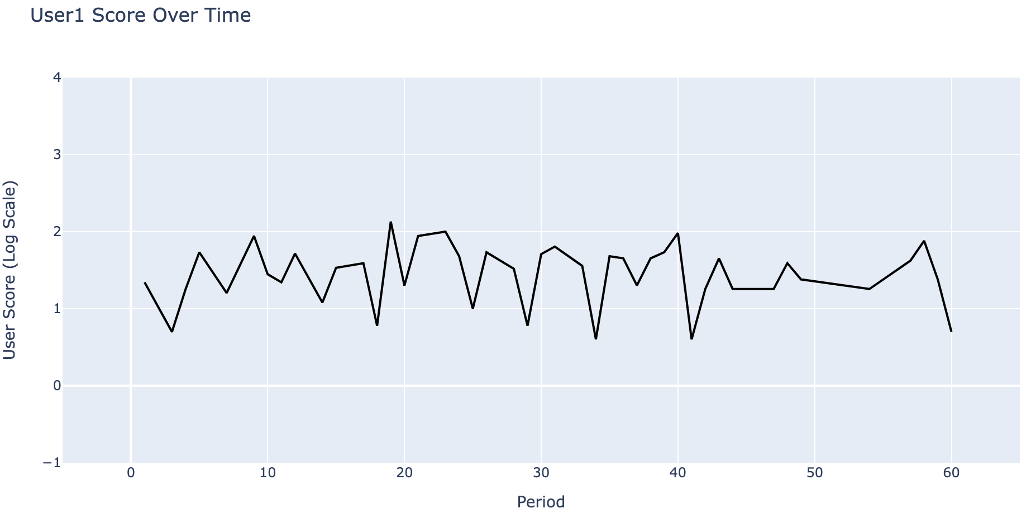
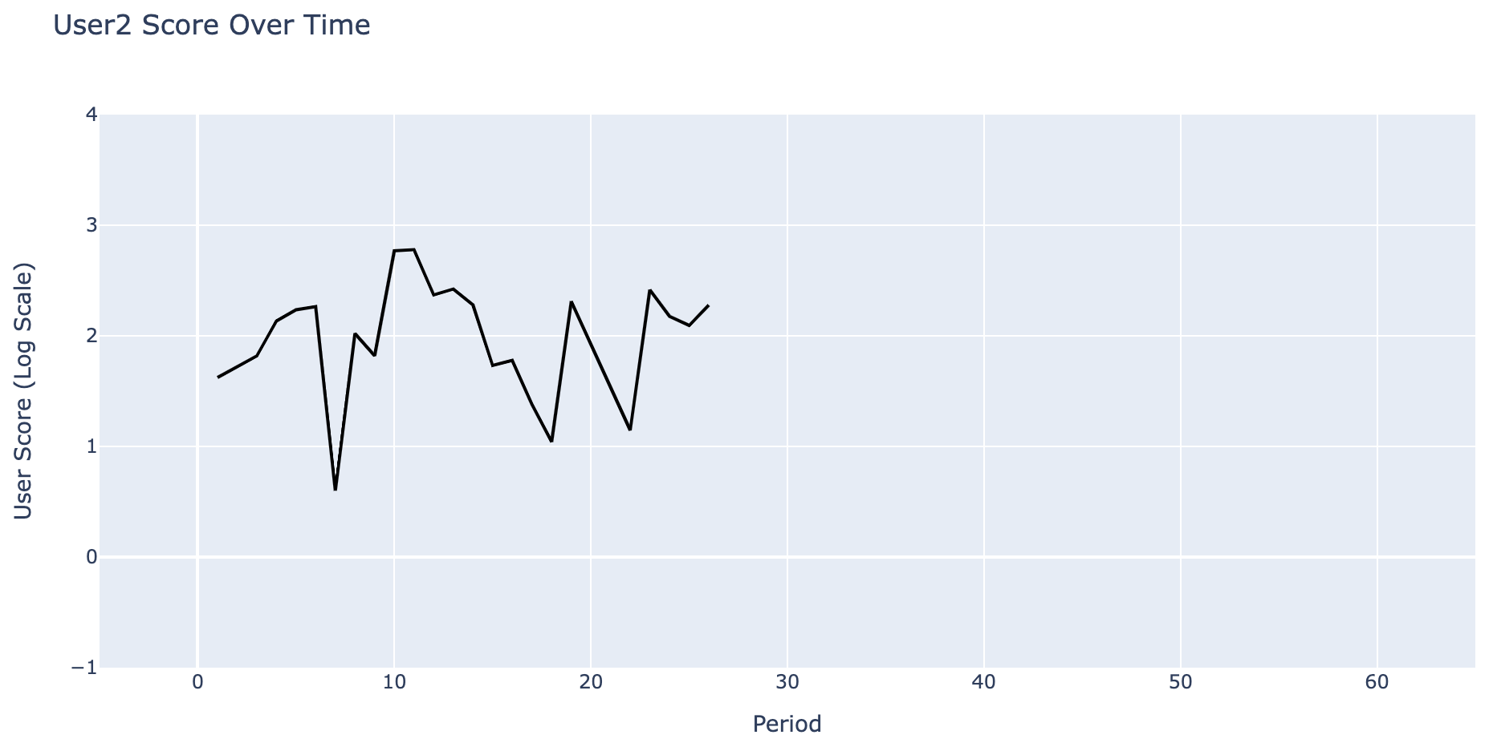
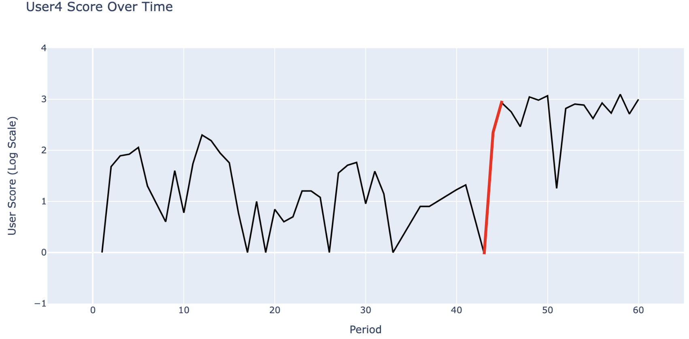
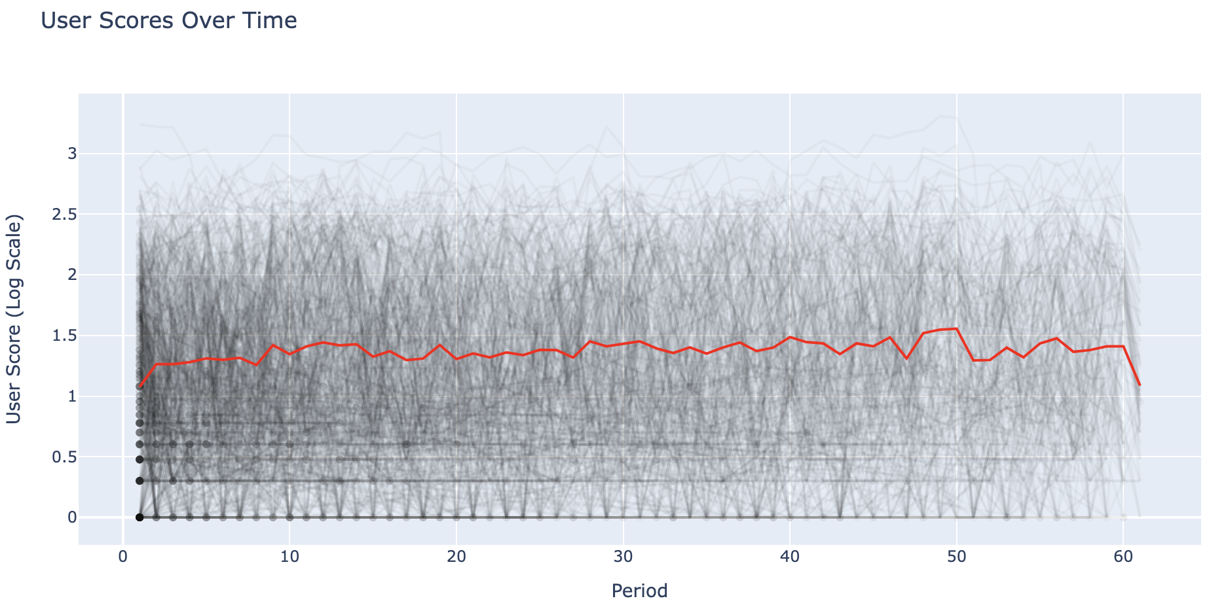
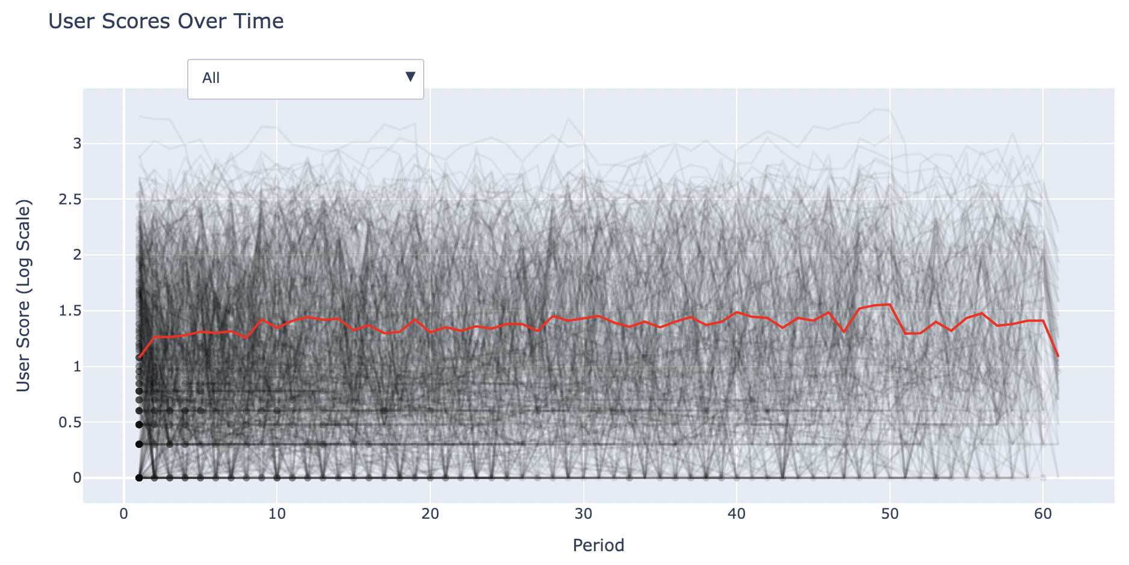
Visualization

Slide 10
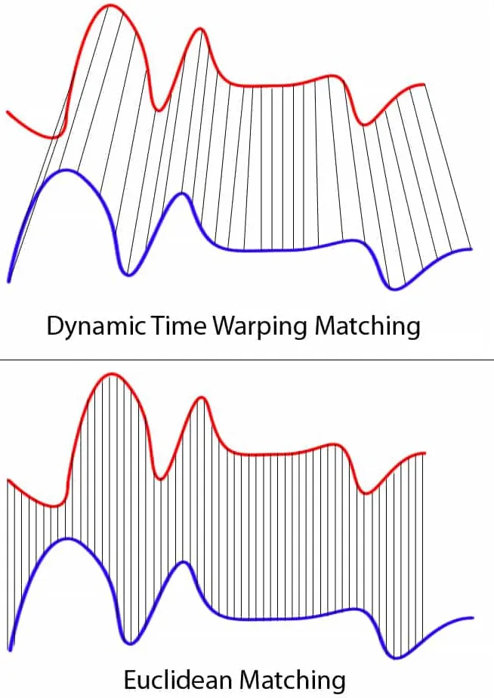
Unsupervised Learning Model
We have the time-series data without labels!
K-means Clustering for time-series
Instead of clustering “data points”, it clusters time-series
Input is the time-series for each user across the whole time range
Minimize the distances between time-series within the same clusters
Distance is measured by Dynamic Time Warping (DTW) or Soft-DTW metric, which measures the distance between two time-series by looking at distances between pairs of closest time points.
We only used the user score as the feature to cluster the time-series

Slide 11
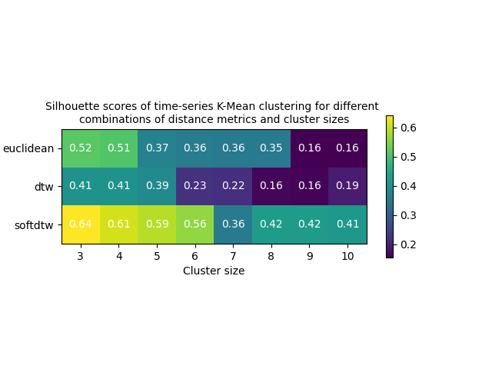
Results
Model using softdtw and cluster size 3 is the best
Notes:
This is the Heapmap for the performance of time series K-means Clustering Model.
The performance is measured by Silhouette score which is a common metric to measure the performance of clustering models.
Higher score means better clustering performance.
As the heatmap shows the k-means clustering with the pair of cluster size 3 and softdtw distance metric performs the best, so we choose this parameters to train our model.

Slide 12
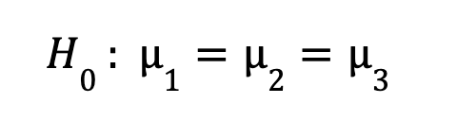
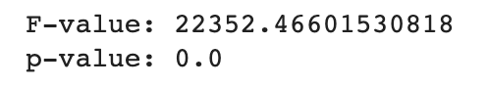
Statistical Testing
One-Way ANOVA (User score)
P value = 0.0 < 0.05, we reject the null hypothesis and conclude that there is a significant difference among those three clusters.
Notes:
To validate if three clusters are different, we perform one-way anova. Our null hypothesis is that the mean of user score in cluster 1 = 2=3. Our result shows that the p value is less than 0.05…….

Slide 13
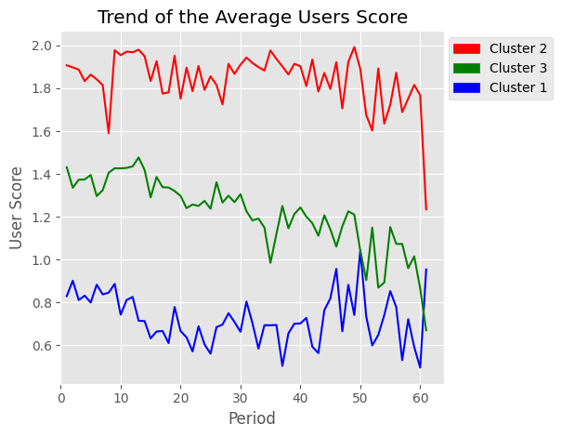
Trend for the mean(USER_SCORE) feature
Notes:
we also plot the trend of the average user score.
We can clearly see there are gaps between the times series of different clusters, which indicates our clustering model divided time series appropriately
Each times series seem to have different trend:
If We look at the overall trend, we can see that
Red line doesn’t seem to change a lot across the time
Green line shows a decrease pattern
Blue line seems to be more complicated. It decrease first and increase latter

Slide 14
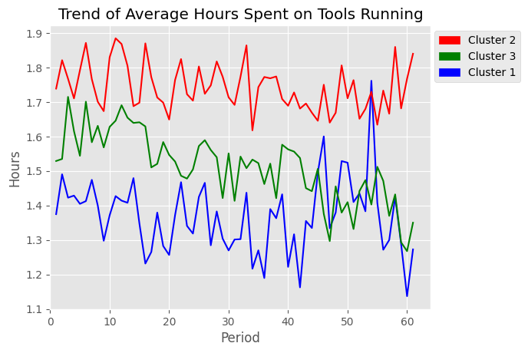
Trend for the mean( UNIQUE_HOURS_RUN) feature
Notes:
We also check other numerical variable like unique)hour_run and we make the plot of trend of average hours spent on tools running.
We can see it has similar order and trend for three lines

Slide 15
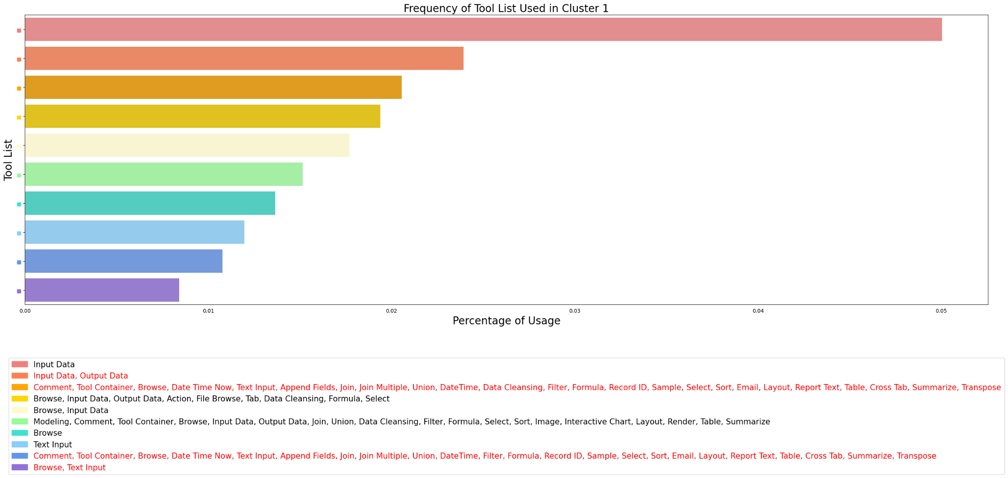
Percentage of Usage of Top 10 Tool Lists in Cluster 1
Note:
Legend texts in red indicate the distinct tool lists for cluster 1 users

Slide 16
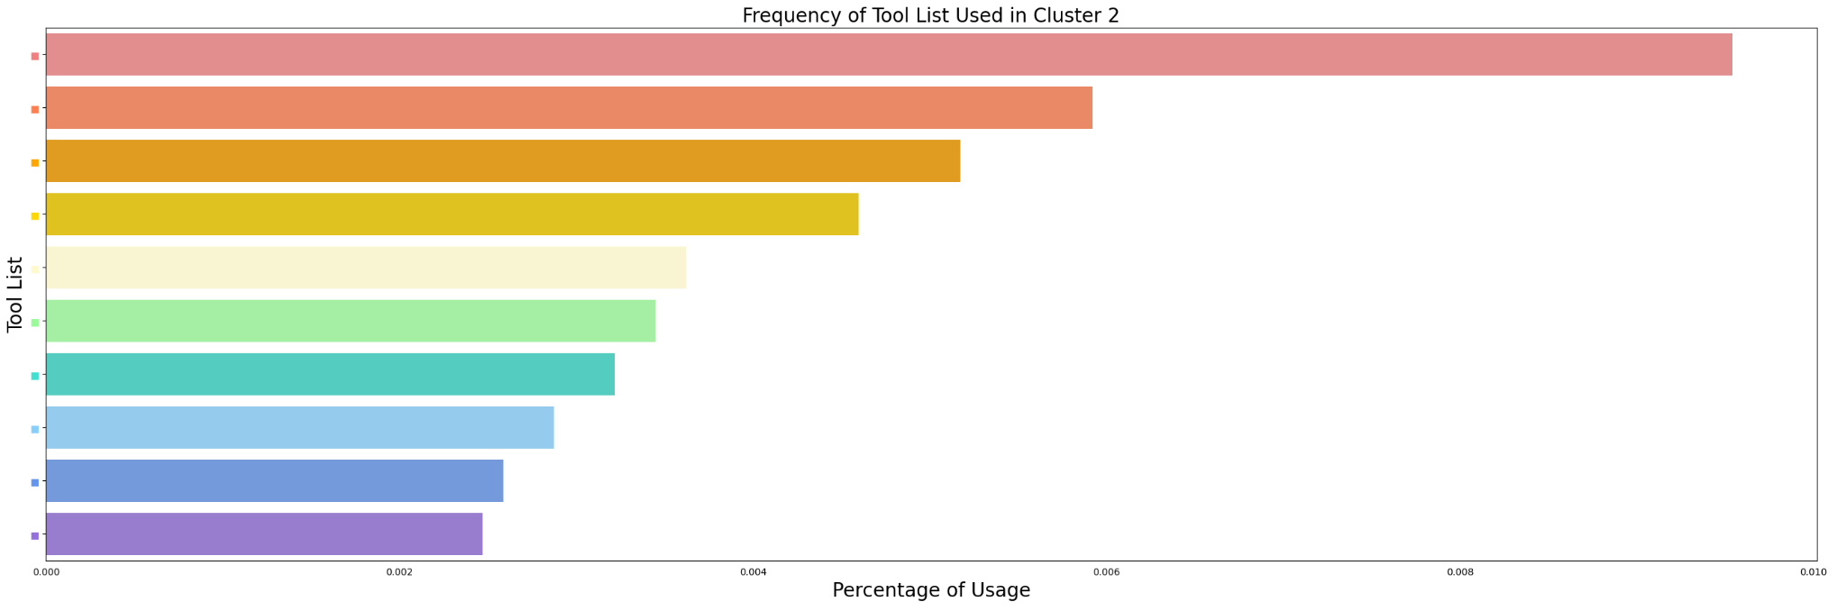
Percentage of Usage of Top 10 Tool Lists in Cluster 2
Note:
Legend texts in red indicate the distinct tool lists for cluster 2 users
Notes:
Cannot fix the font size of the legend

Slide 17
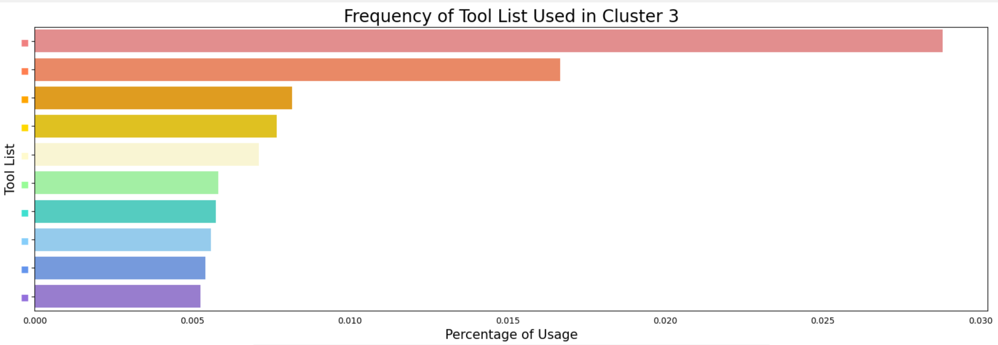
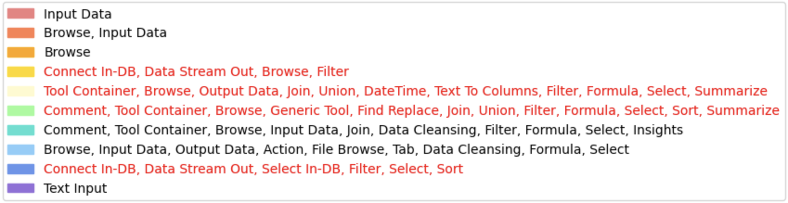
Percentage of Usage of Top 10 Tool Lists in Cluster 3
Note:
Legend texts in red indicate the distinct tool lists for cluster 3 users

Slide 18
Trend for the mean(USER_SCORE) feature
Notes:
After we trained the clustering model, we plot the trend of the average user score.
We can clearly see there are gaps between the times series of different clusters, which indicates our clustering model divided time series appropriately
Each times series seem to have different trend:
If We look at the overall trend, we can see that
Red line doesn’t seem to change a lot across the time
Green line shows a decrease pattern
Blue line seems to be more complicated. It decrease first and increase latter

Slide 19
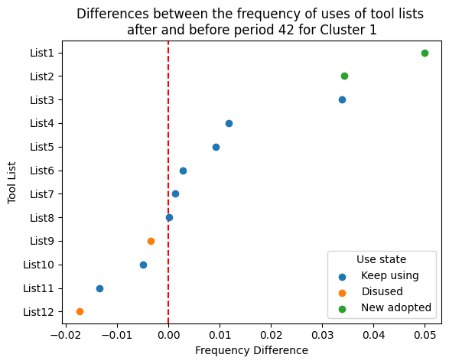
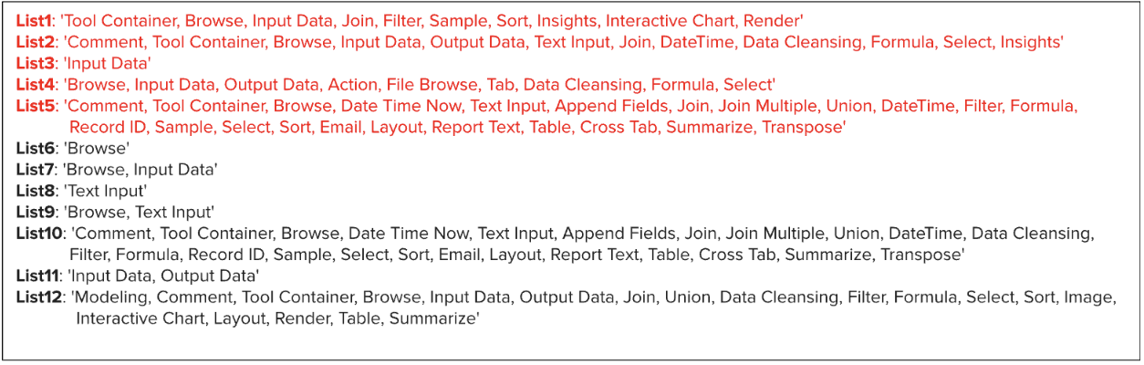

Slide 20
Conclusion & Discussion
After clustering users and analyze user behavior, we have identified 5 series of events (tools usage) that might relate to increased Alteryx product usage
Each cluster has its unique trend of user scores
Different clusters have different tool usages
There are some changes in tool usages along with the sharp increase in user scores
We would recommend tool lists with frequency increase greater than 1%
If we have more time:
Obtain more information and more recent data
We can also look at other aspects of tool usages such as how many times they were run (TOTAL_RUN).

Slide 21
Q&A
Thank you!

